Slide 1

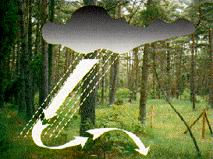


ICP Integrated Monitoring of Air Pollution Effects on Ecosystems -
ICP IM
Achievements & Priorities
2015-2017
Lars Lundin and Martin Forsius
Swedish University of Agricultural Sciences

Slide 2
Scope of ICP IM
ICP IM TF 2015
Focus of work 2016/2017
Key results and achievements
Future plans; workplan 2016-2017
ICP IM TF 2016
Swedish University of Agricultural Sciences
Notes:
2

Slide 3
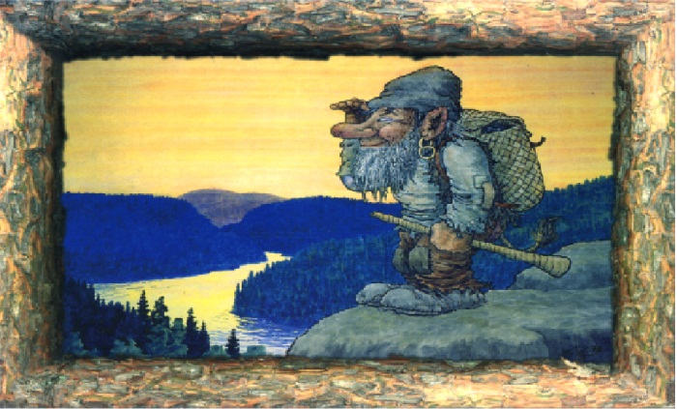
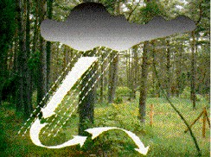

ICP Integrated Monitoring
Ecosystem investigation
Monitor state and changes with causative explanations
Develop and validate models
Detect changes by biomonitoring
Cause-effect approach
Cross-media flux approach

Slide 4
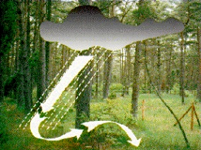
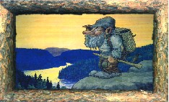
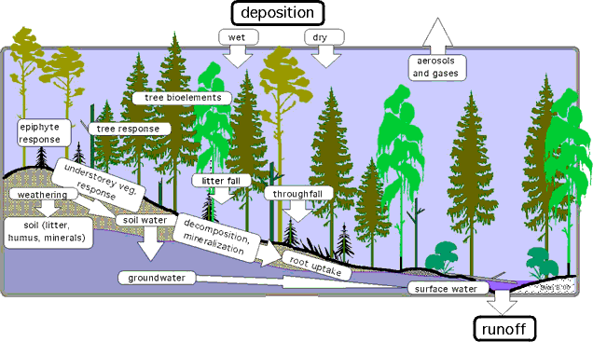

Integrated Monitoring
Catchment approach
Budget calculations
Process oriented
Swedish University of Agricultural Sciences
Notes:
Integrated monitoring of ecosystems means physical, chemical and biological measurements over time of different ecosystem compartments simultaneously at the same location. In practice, monitoring is divided into a number of compartmental subprogrammes which are linked by the use of the same parameters (cross-media flux approach) and/or same or close stations (cause-effect approach).
The full implementation of the ICP IM will allow ecological effects of heavy metals, persistent organic substances and tropospheric ozone to be determined. A primary concern is the provision of scientific and statistically reliable data that can be used in modelling and decision making.

Slide 5
Database update – data from 2014
2015-12-01:
c. 13 countries
c. 40 countries for period 2009 – 2014
By 2014-12-01 data was reported for 2013
Swedish University of Agricultural Sciences
Notes:
5

Slide 6
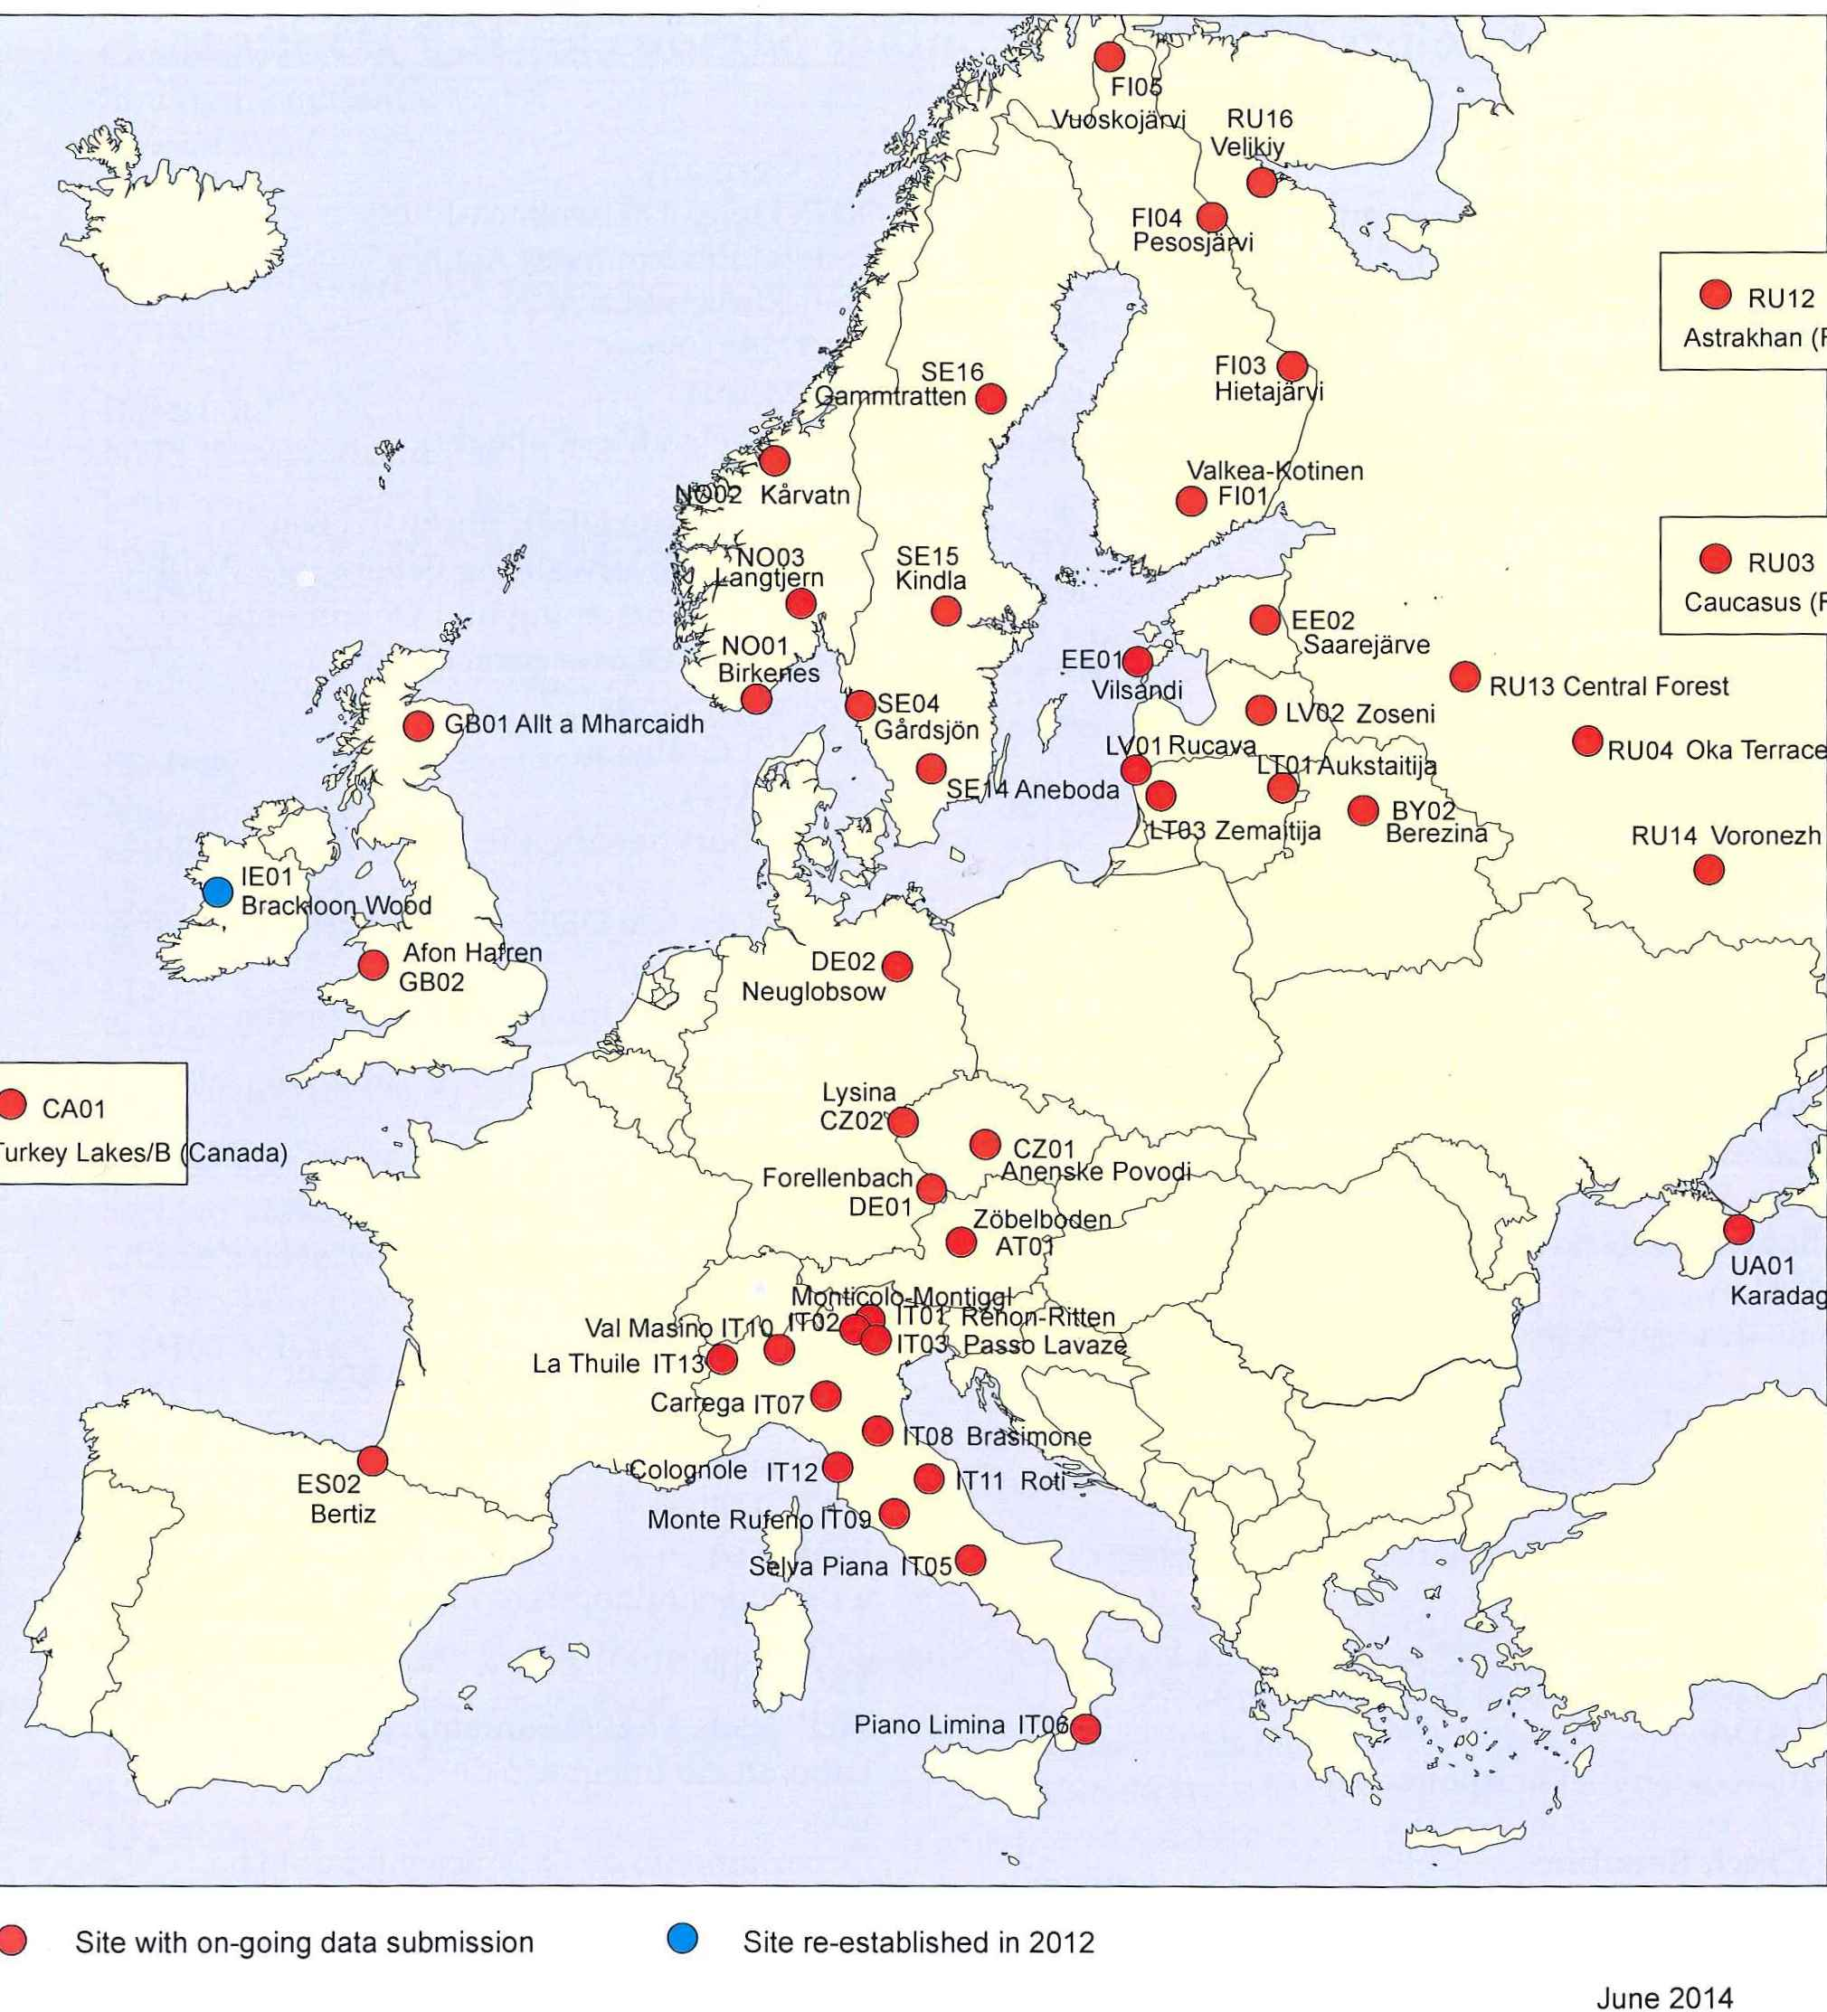
Integrated monitoring sites
17 countries
40 active sites
Ukraine 1
Norway 2 new
Ireland restart
Switzerland one new site
Poland with intentions
Swedish University of Agricultural Sciences
Notes:
The ICP IM sites (mostly forested catchments) are located in undisturbed areas, such as natural parks or comparable areas. The ICP IM network presently covers forty-seven
sites from seventeen countries. The international Programme Centre is located at the Finnish Environment Institute in Helsinki.

Slide 7
IM Task Force meeting 6-8 May 2015
Minsk Belarus
30 participants from 12 countries and
ICP Waters and ICP Forests
Kind invitation from
Ministry of Natural Resources and Environmental Protection
Organisation Marina Philipyuk and Anatoly Srybny
Workshop first day
Task Force second day
Excursion to the Berezinski Biosphere Reserve
Swedish University of Agricultural Sciences

Slide 8
Ongoing priority work items
Biodiversity indicators and issues related to CL and modelling
Work on HM baseline, budgets and critical loads
Update results on mass balances for sulphur and nitrogen
Common EMEP and WGE Trends report – Now published
Collaboration between IM, EU projects and LTER Europe
Common workplan items related to CLRTAP strategy (e.g. CLRTAP Assessment report).
Swedish University of Agricultural Sciences

Slide 9
Common ICP, TF Health and JEG Trends report
ICP IM Contributions
Acidification
Eutrophication
Biodiversity
Heavy metals
Swedish University of Agricultural Sciences

Slide 10
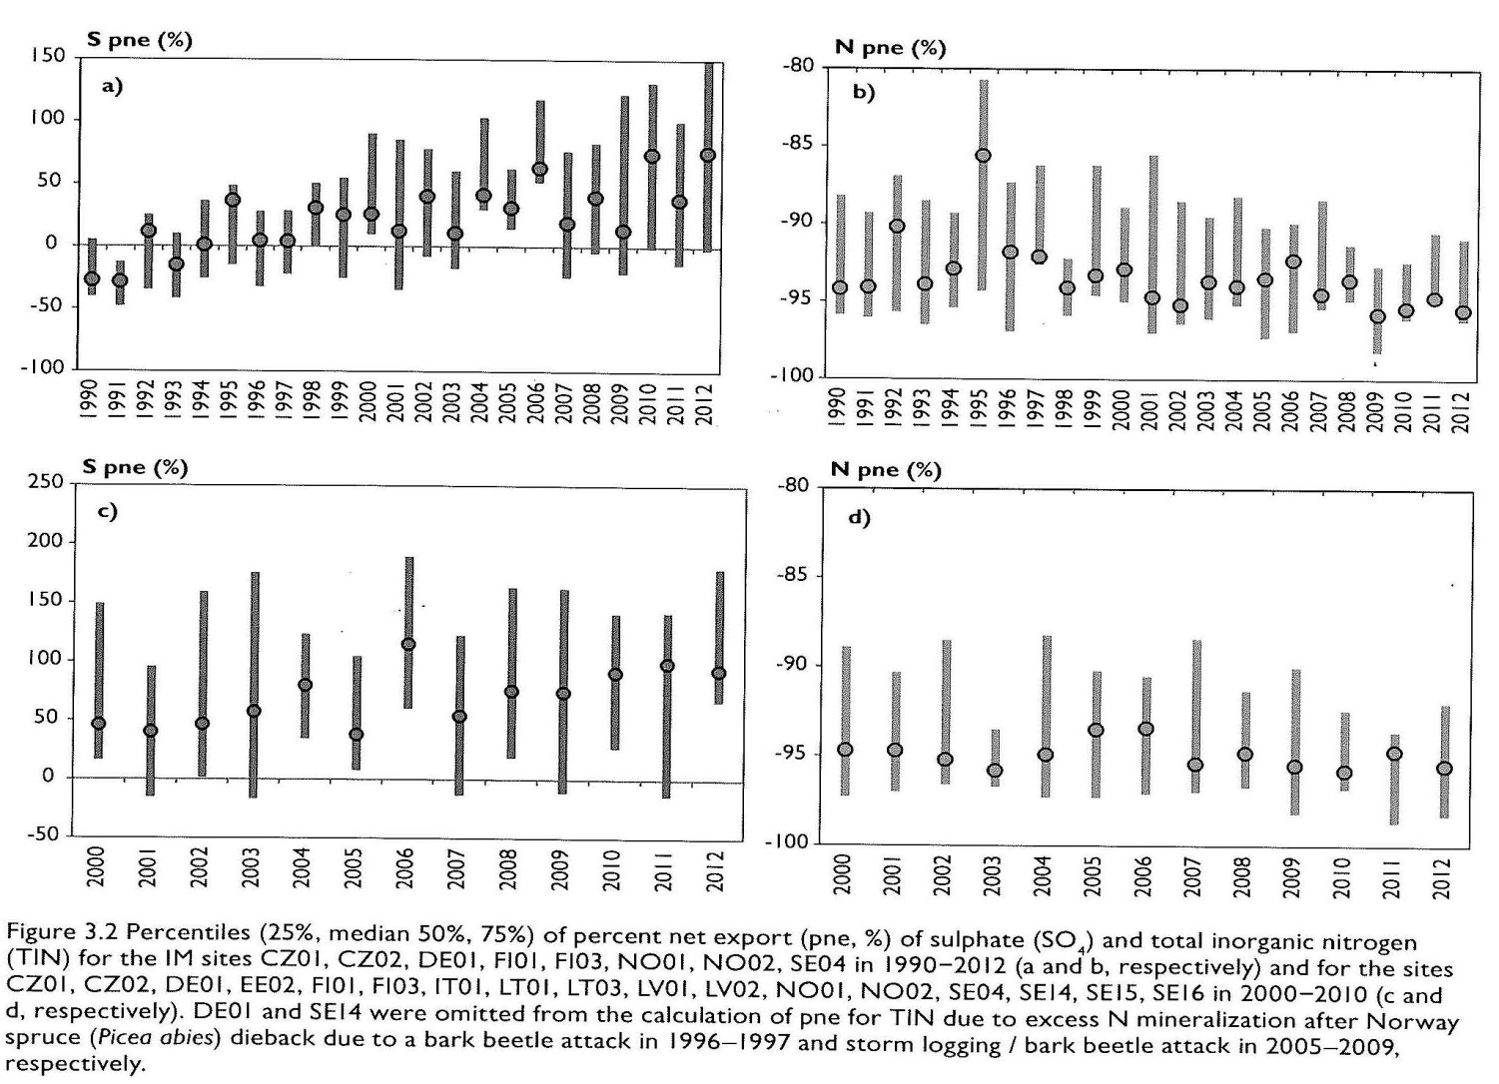
Report and scientific paper on mass balances and
indicators for sulphur and nitrogen in catchments
Swedish University of Agricultural Sciences

Slide 11
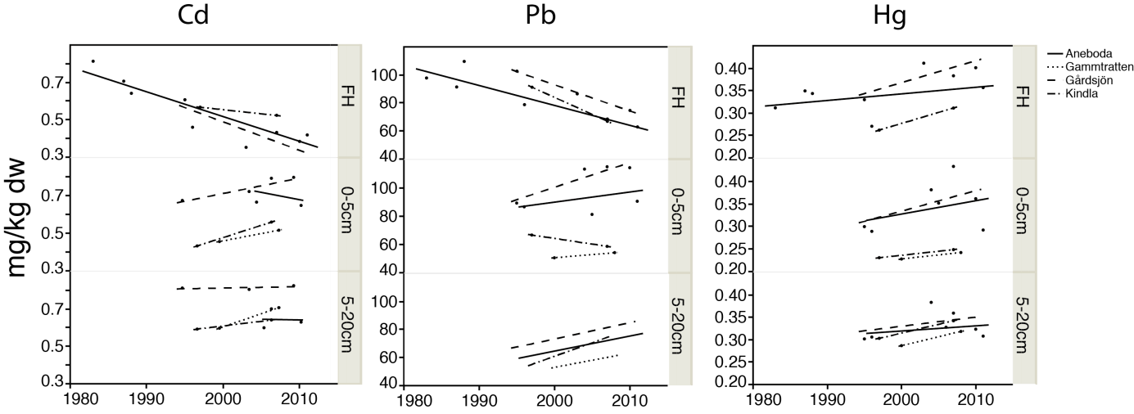
Metal content in the soil during 1980-2012 in Swedish IM-sites decrease in the humus layer but increase in deeper layers
Hg increases in all layers
Swedish University of Agricultural Sciences

Slide 12
Planned ICP IM work and reports 2016-2017
ICP IM 25th Annual Report 2016 and WGE Joint report
Report (2016) on dynamic responses of vegetation changes in relation to N – Scientific paper in 2017
Report on assessing long-term trends of S and N effects and scientific paper
Report on HM trends and budgets (2017)
Progress report on mercury with ICP Waters
Report on connections between calculated CL exceedances and observed impacts of N (2017)
In 2016 the 24th ICP IM Task Force meeting joint with ICP Waters
Swedish University of Agricultural Sciences
Notes:
12

Slide 13
Increased possibilities to deliver required science in the future
Intense collaboration between ICP:s:
Increase the monitoring regions
Increase policy oriented assessments
EC collaboration projects; New Horizon 2020
ICP IM relates to
ALTER-Net II
LTER Europe
LIFE Watch http://www.lifewatch.eu/
EnvEurope
EU Cost action FP0903
EU projects SoilTrEC, Expeer …
Swedish University of Agricultural Sciences
Notes:
ALTERNet A Long-Term Biodiversity, Ecosystem and Awareness Research Network
LifeWatch: e-Science and Technology Infrastructure for Biodiversity Research
FutMon
- a LIFE+ co-financed project for the "Further Development and Implementation of an EU-level Forest Monitoring System".
A project for the creation of a pan-European long term forest monitoring system.
The project coordination centre is situated at the Institute of World Forestry, Hamburg, Germany.
FutDiv Future forest biodiversity monitoring in Europe

Slide 14

Main features of the EU Horizon 2020 eLTER project
Swedish University of Agricultural Sciences

Slide 15

Cooperation with other ICPs
Trends report common for all ICPs
Dynamic modelling together with ICP M & M
Potential cause effects report with ICP Forests
Joint Assessment report EMEP and WGE
Joint TF with ICP Waters in 2016
Swedish University of Agricultural Sceinces

Slide 16
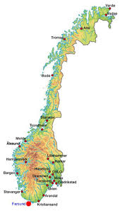

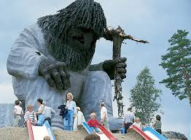
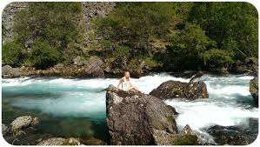
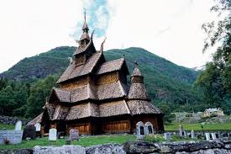
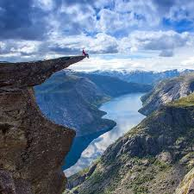
ICP IM TF 2016
in May in Norway with ICP Waters
The host
Thank You for attention!
Water and Forest
Not the venue
Nature

